Slide 1
Securing the Grid Sequential Anomaly Detection in ICS Traffic Using LSTM Autoencoders
Jorel Abrantes Applied Mathematics, Clovis Community College
Mentor: Dr. Meng Yue Energy Systems Division, Interdisciplinary Science Department, Brookhaven National Laboratory
3/18/2026

Slide 2
Power Grids Are Under Attack
2015-16
2021
Today
Ukraine Power Grid
First confirmed cyberattacks to cause blackouts. 230,000 customers left without power.
Florida Water Treatment
Attacker remotely altered chemical levels to dangerous concentrations via remote access.
Growing Attack Surface
SCADA/ICS adoption is accelerating. The protocols governing them were never designed for cybersecurity.
These incidents prove that ICS vulnerabilities have real physical consequences.

Slide 3
Modbus Was Built for Reliability, Not Security
Modbus Protocol
Developed in 1979
Governs PLC/SCADA communication in substations
Predictable, low-latency request-response cycles
No built-in authentication or encryption
Dominant in power grid environments worldwide
The Detection Challenge
Supervised models require labeled attack data
Novel & zero-day attacks won't be in training labels
Retraining on new signatures is operationally impractical
Our approach: train only on normal, flag deviations

Slide 4
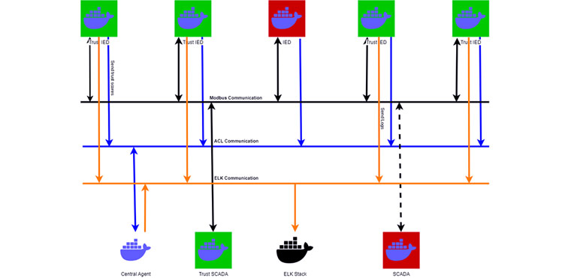

Slide 5
CIC Modbus Dataset 2023 / 5 Key Features
Dataset
9 attack categories
3 attacker configurations:
External Attacker
Compromised IED
Compromised SCADA HMI
PCAP captures from Docker-based IED/SCADA testbed
48 extracted features per flow, then narrowed down to 5
Top 5 Features (Spearman p)
Feature | Correlation |ρ|
bit_count | 0.982
reference_num | 0.976
word_count | 0.961
function_code | 0.920
requests_per_second | 0.864

Slide 6
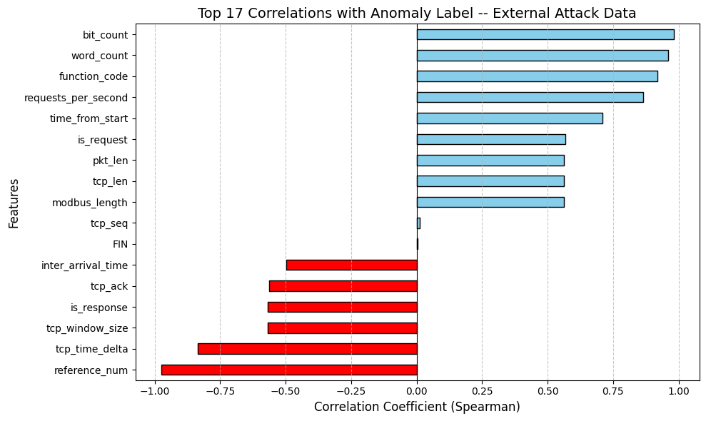

Slide 7
LSTM Autoencoder Architecture
Input Sequence
50 packets x 5 features
LSTM
Encoder
2-layer, hidden=64,
Compresses to latent vector
Latent Vector
Fixed-length representation of normal behavior
LSTM
Decoder
2-layer, reconstructs original sequence
MSE
Error
Score

Slide 8
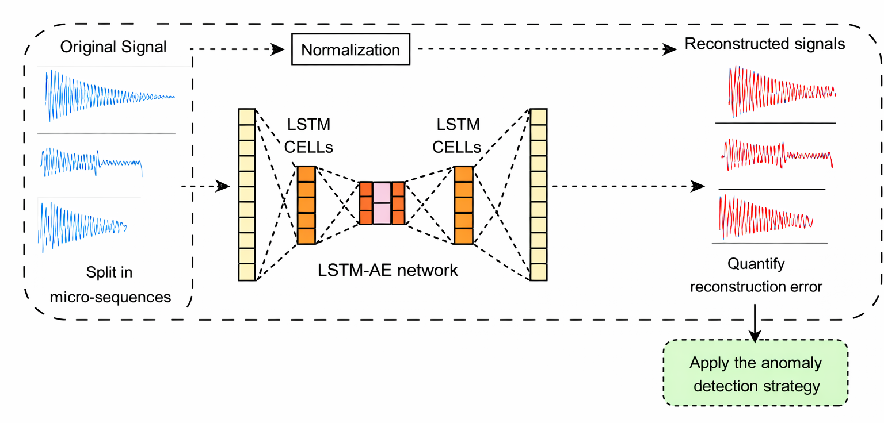
LSTM Autoencoder Architecture cont.
Training Details
Trained on benign traffic only
MSE loss
Adam optimizer (lr= 0.0001)
Batch=64
ReduceLROnPlateau · Gradient clipping (max norm=1.0) · 50 epochs
Threshold: 95th or 99th percentile of training reconstruction error distribution
Key Insight
Normal traffic → low reconstruction error.
Attack traffic → model struggles → high error → flagged.

Slide 9
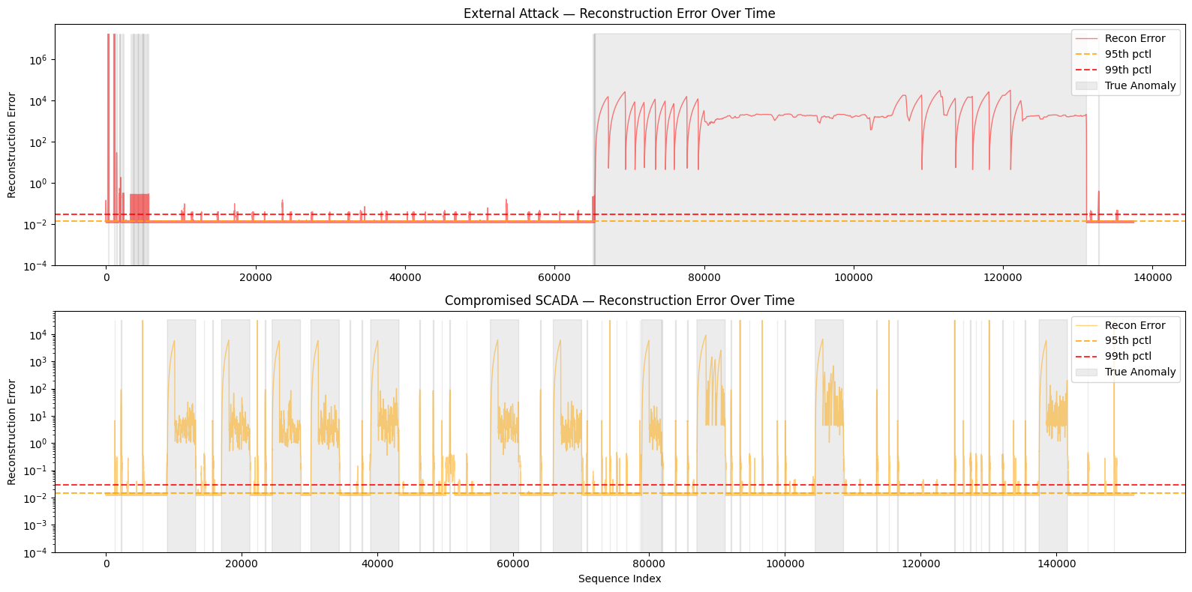

Slide 10
Strong Performance Across Both Attack Scenarios
95th Percentile Threshold
99th Percentile Threshold
Scenario | Precision | Recall | F1 | AUC-ROC
External Attack | 0.96 | 1.00 | 0.98 | 1.0000
Compromised SCADA | 0.80 | 1.00 | 0.98 | 0.9983
Scenario | Precision | Recall | F1 | AUC-ROC
External Attack | 0.99 | 1.00 | 0.99 | 1.0000
Compromised SCADA | 0.84 | 1.00 | 0.91 | 0.9983
99.98%
1.0000
0.9983
0 Labels
Overall Accuracy
AUC-ROC - External Attack
AUC-ROC - Comp. SCADA
Used in Training

Slide 11


What the Results Tell Us
No labeled attack data needed at train time
Can detect novel / zero-day attacks by definition
Precision trade-off vs supervised is acceptable for complementary detection layer
Precision drops to 0.80–0.84 vs 0.96–0.99 on External Attack
Internal attacker traffic resembles normal patterns more closely
Recall stays at 1.00, no true attacks missed
Compromised SCADA
Is Harder
Why Unsupervised?

Slide 12
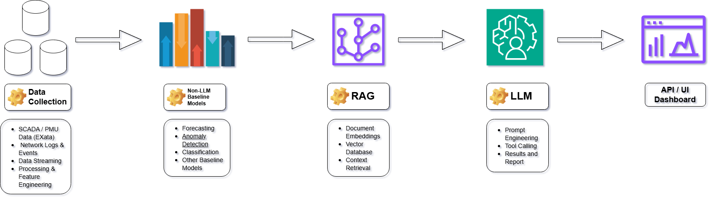
Toward a Foundational Model for Grid Security

Slide 13
Thank You.

Slide 14
Thanks and Acknowledgements
This project was supported in part by the U.S. Department of Energy, Office of Science, Office of Workforce Development for Teachers and Scientists (WDTS) under the Community College Internships Program (CCI).
I want to thank my mentor, Dr. Meng Yue, for guidance and support throughout this project.

